Slide 1
Wrist and Hand
ANAT 505
Pacific Northwest University of Health Sciences
Ron Walser, DPT
Any recording of this lecture should be considered “unedited”. If there is a discrepancy between a recording and your class handout, please consider the handout to be correct unless notified otherwise.
This work may be protected by copyright (Title 17, U.S. Code).

Slide 2
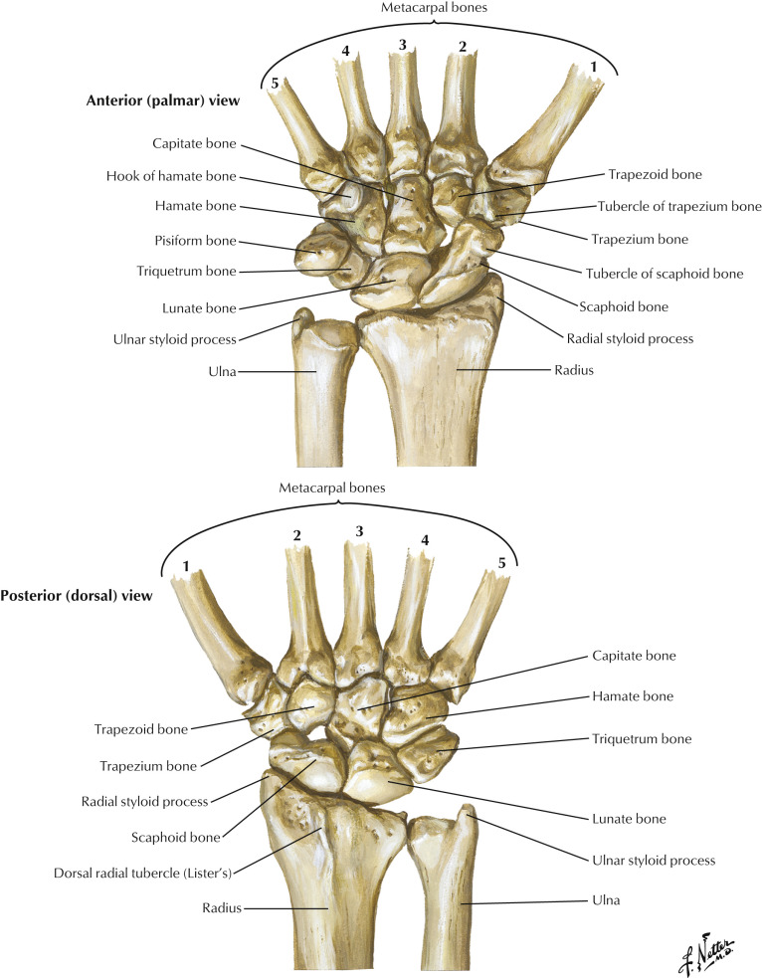
Carpals
Proximal row (lateral to medial)
Scaphoid
Lunate
Triquetrum
Pisiform
Distal row (lateral to medial)
Trapezium
Trapezoid
Capitate
Hamate
Copyright © 2019 by Saunders, an imprint of Elsevier Inc.

Slide 3
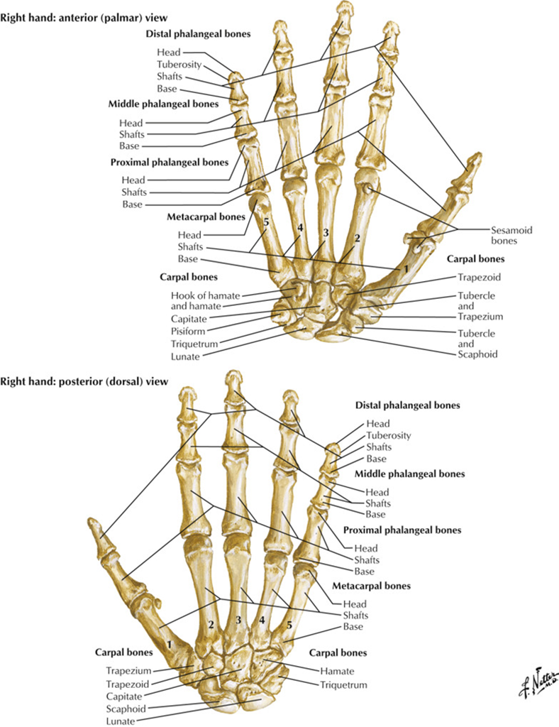

Metacarpals and phalanges
Copyright © 2019 by Saunders, an imprint of Elsevier Inc.

Slide 4
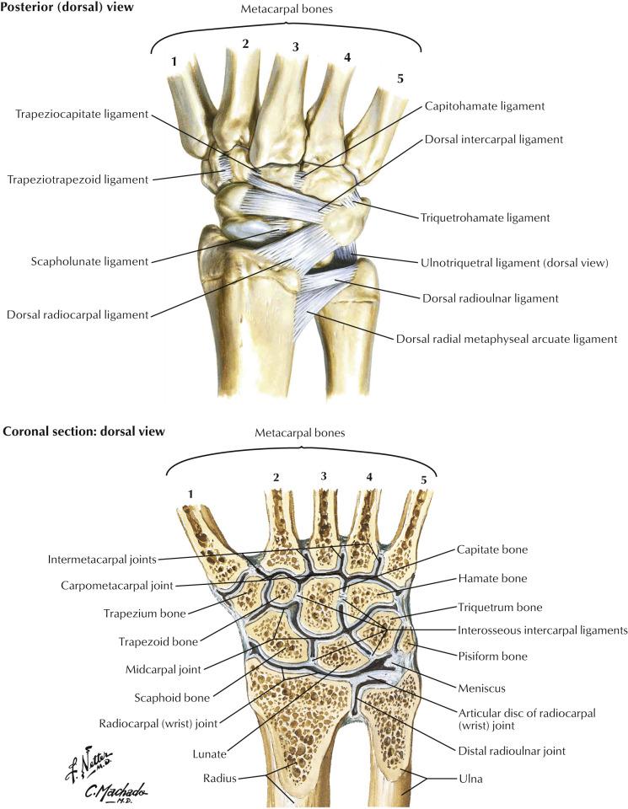
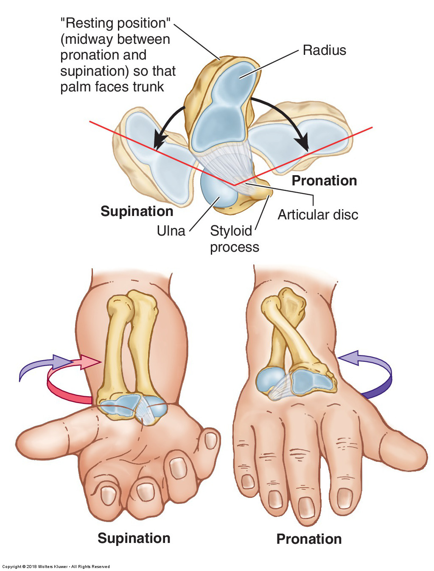
Distal radioulnar joint
Pivot joint
Head of ulna
Ulnar notch of radius
Articular disc
L – shaped joint
Anterior and posterior ligaments
Pronation/supination movements
Copyright © 2019 by Saunders, an imprint of Elsevier Inc.

Slide 5
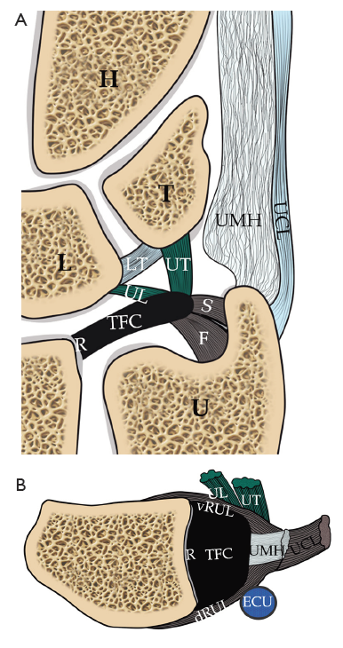

TFCC
Triangular fibrocartilaginous complex (TFCC)
Major components:
Triangular articular disc
Anterior (volar) radioulnar ligament
Posterior (dorsal) radioulnar ligament
Ulnar collateral ligament
Tendon sheath of extensor carpi ulnaris
Ng AWH, Griffith JF, Fung CSY. MR imaging of the traumatic triangular fibrocartilaginous complex tear. Quant Imaging Med Surg 2017;7(4):443-460.

Slide 6

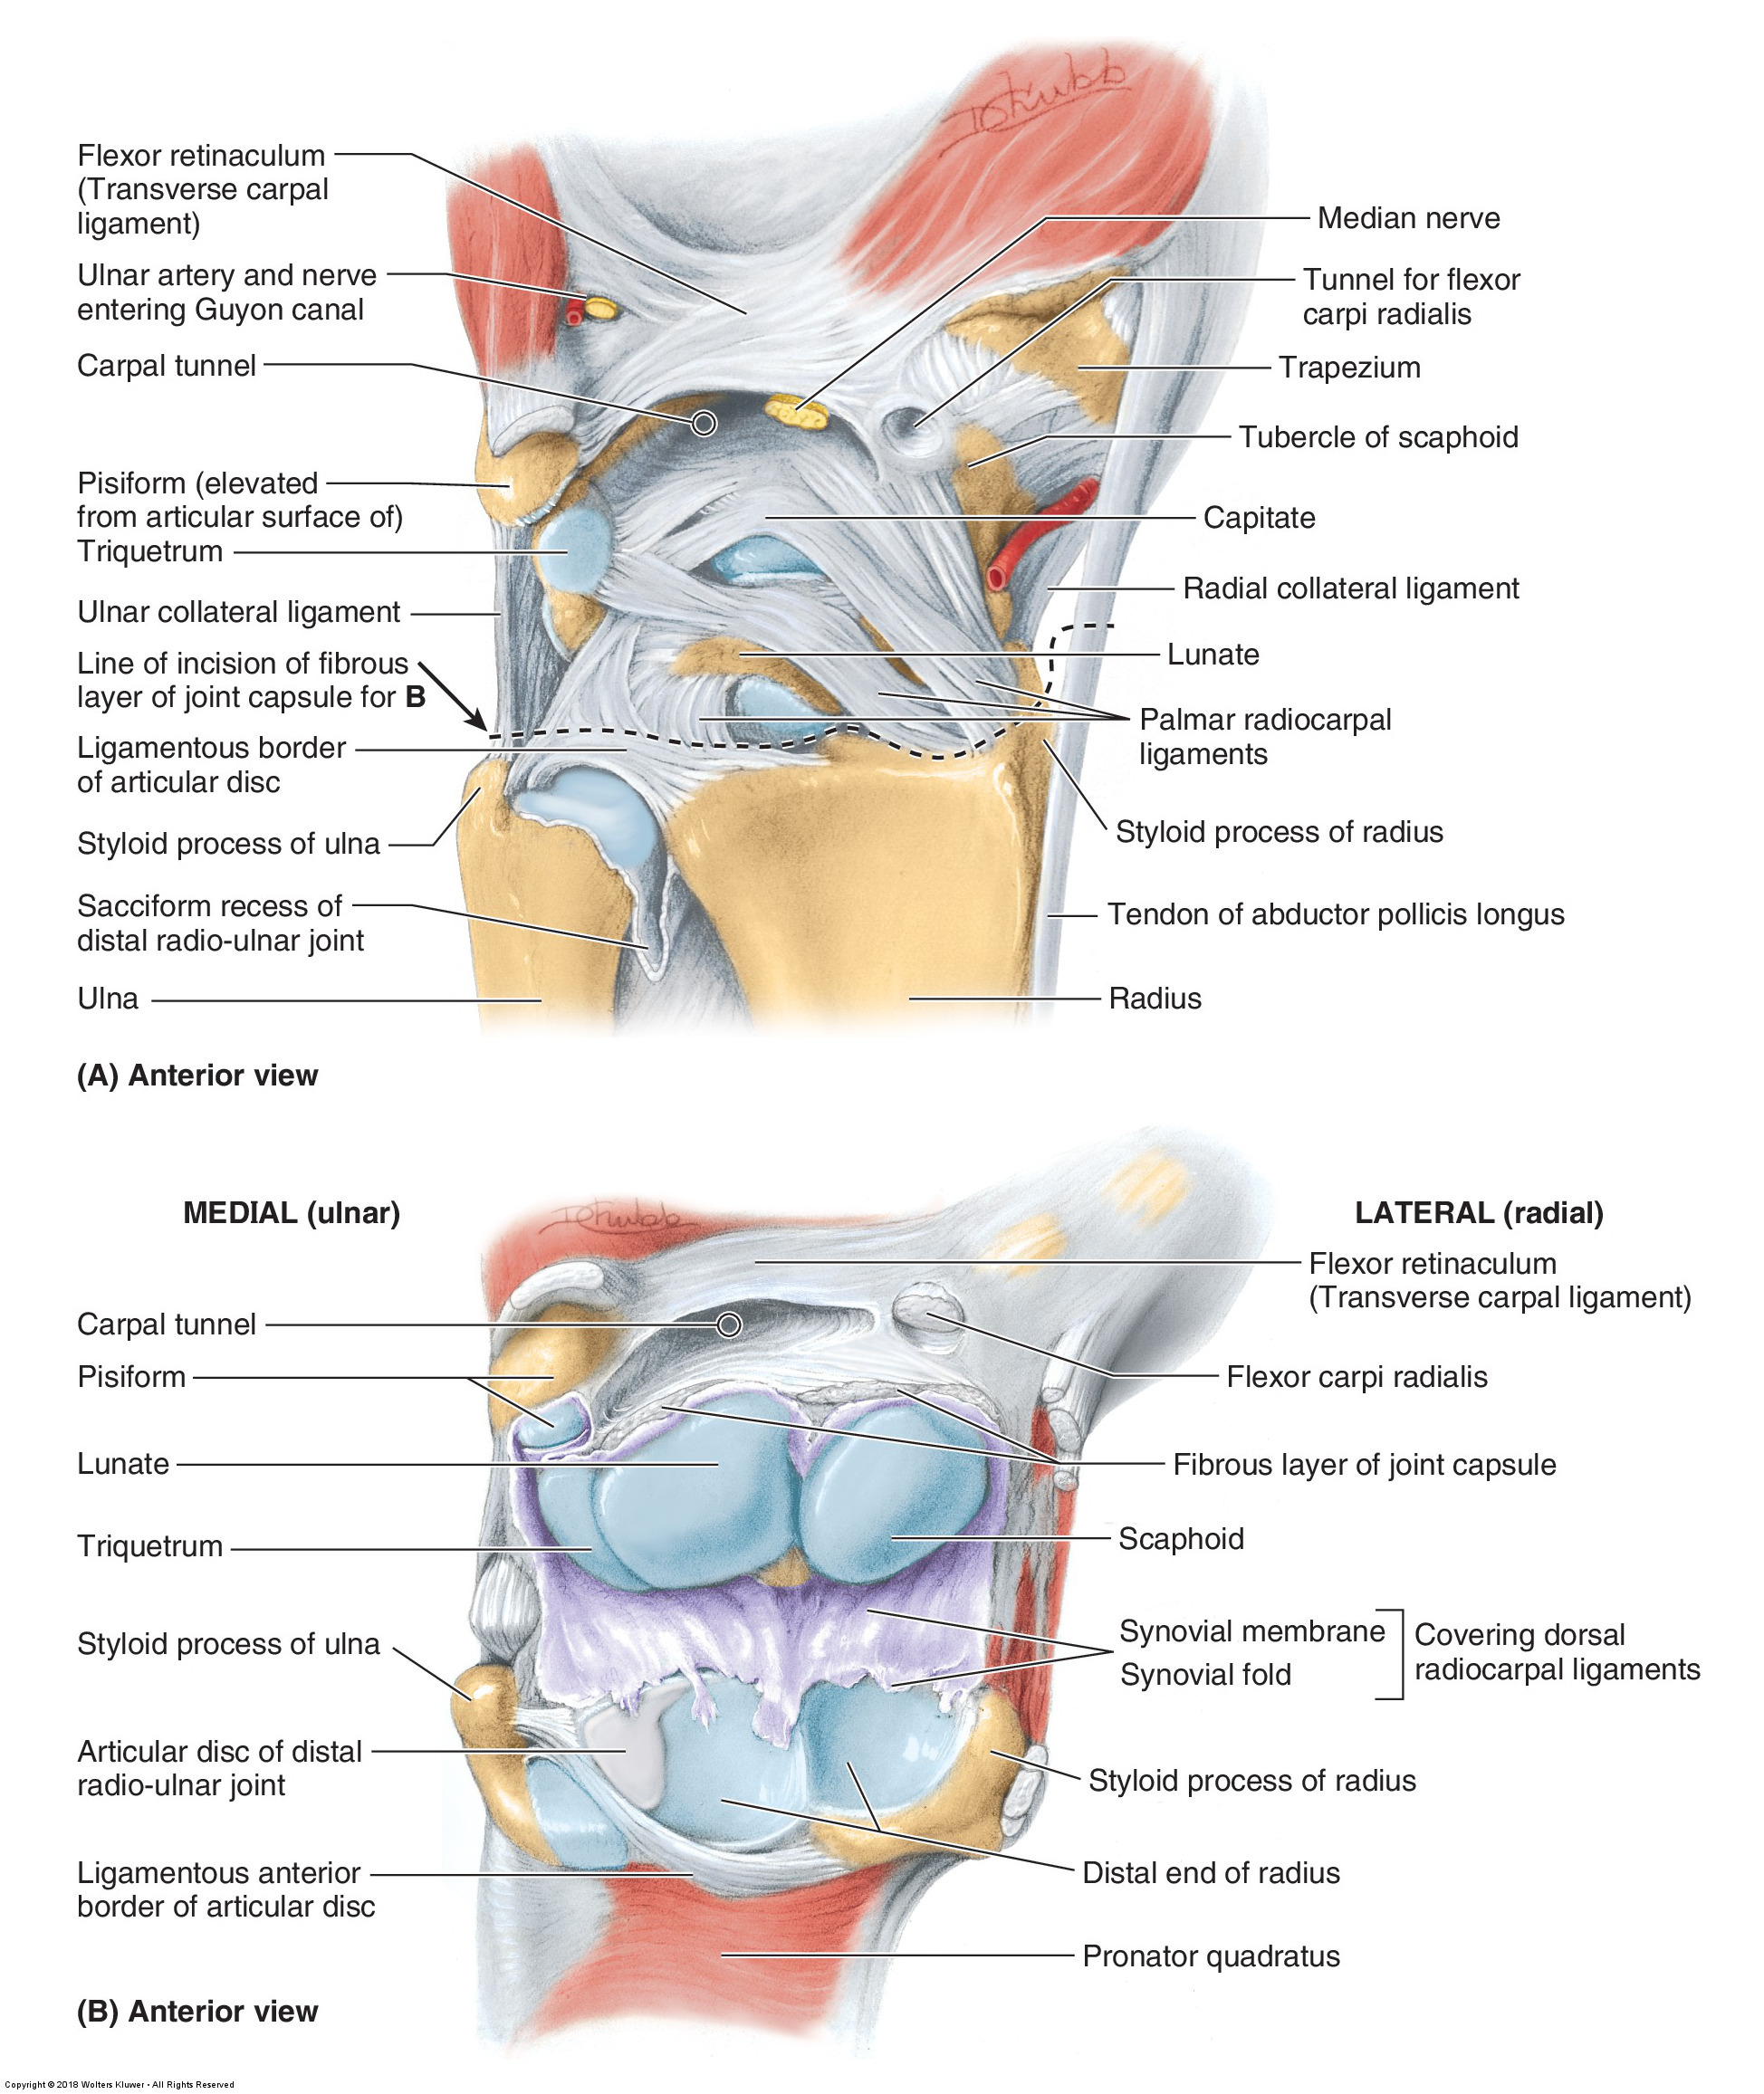
Radiocarpal joint (wrist joint)
Condyloid joint
Distal radius
Articular disc of the distal radioulnar joint
NOTE: The ulna does not directly participate in this joint.
Proximal row of carpal bones (except the pisiform).
Supporting Ligaments: palmar radiocarpal ligaments, dorsal radiocarpal ligaments, ulnar collateral ligament, radial collateral ligament
Movements: flexion, extension, adduction (ulnar deviation), abduction (radial deviation), circumduction.
Copyright © 2019 by Saunders, an imprint of Elsevier Inc.

Slide 7
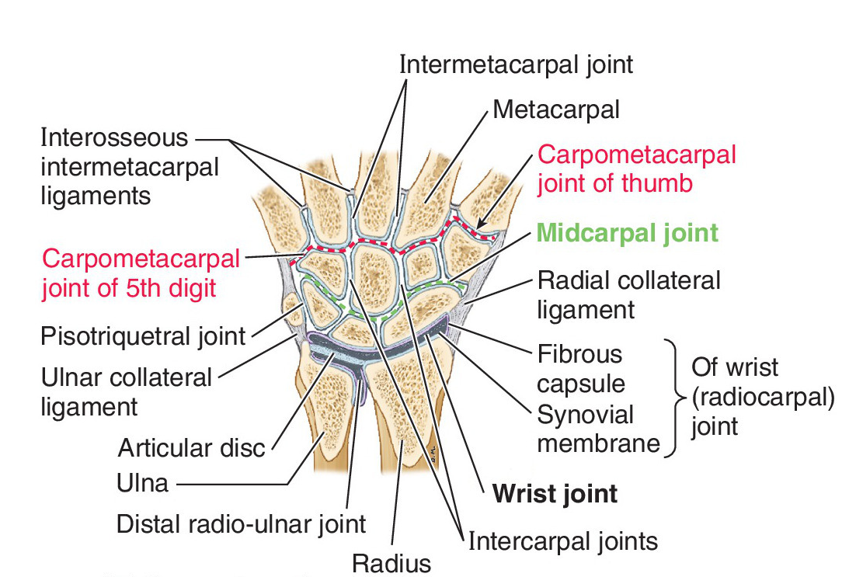
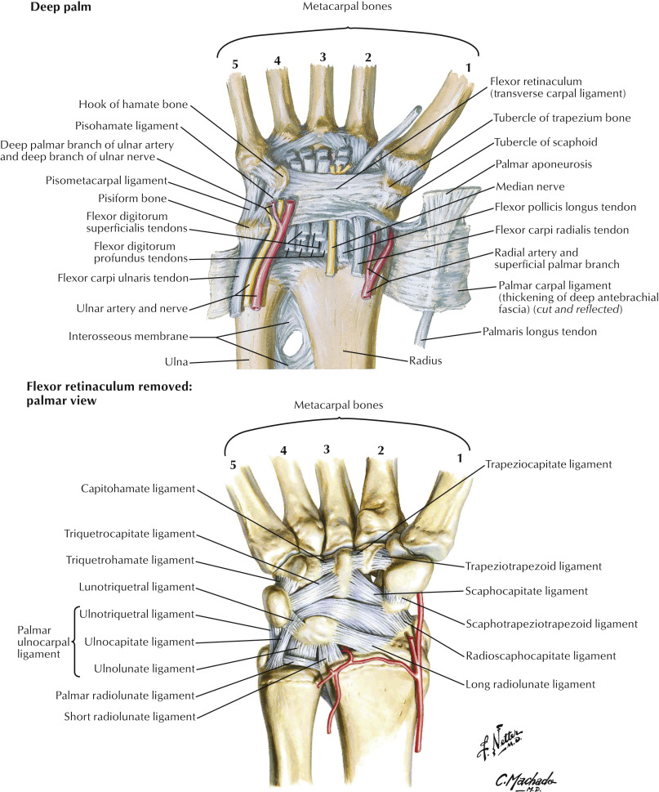
Midcarpal and intercarpal joints
Plane joints.
The midcarpal joint is considered the space between the two rows of carpal bones.
Intercarpal joints are the articulations between each of the individual carpal bones with another carpal bone.
The intercarpal synovial joint capsule surrounds ALL intercarpal joints (including the midcarpal joint) and carpometacarpal joints, EXCEPT the 1st carpometacarpal joint (thumb).
Supporting Ligaments
Anterior, posterior, and interosseous ligaments.
Movements
Gliding movements occur in very small amounts between carpal bones and at carpometacarpal joints.
The midcarpal joint allows for flexion, extension, and abduction (radial deviation) of the hand.
Copyright © 2019 by Saunders, an imprint of Elsevier Inc.

Slide 8
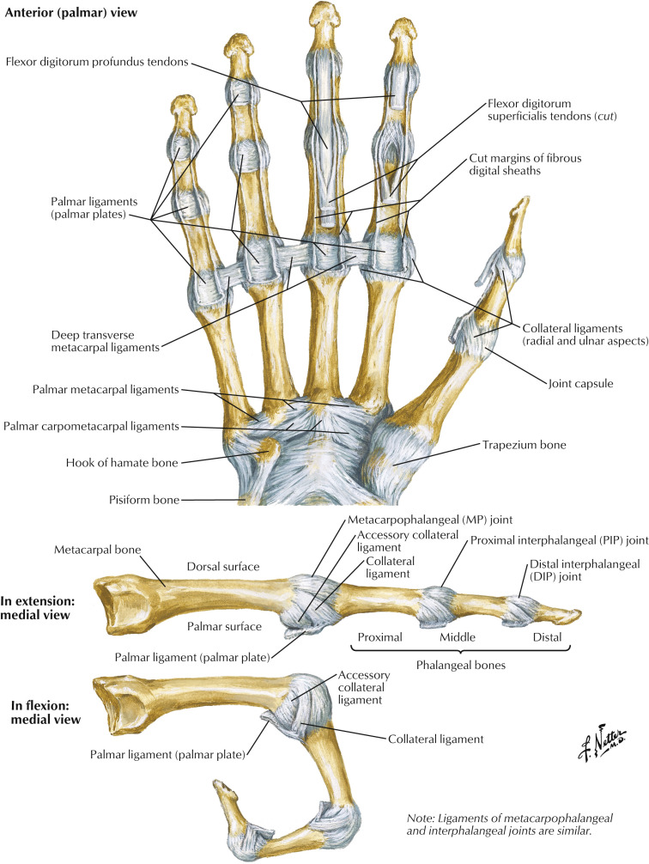
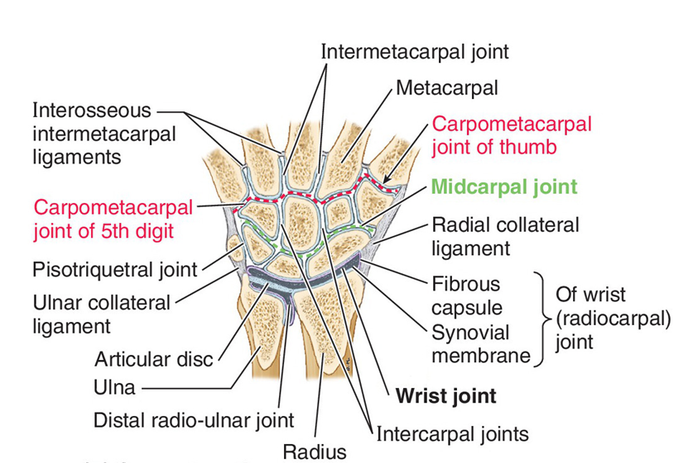
Carpometacarpal and Intermetacarpal joints
Copyright © 2019 by Saunders, an imprint of Elsevier Inc.

Slide 9

1st CMC joint
Saddle joint between trapezium and base of 1st metacarpal bone.
Contained within its own synovial capsule
Movements: flexion, extension, adduction, abduction, circumduction, opposition
Copyright © 2019 by Saunders, an imprint of Elsevier Inc.

Slide 10
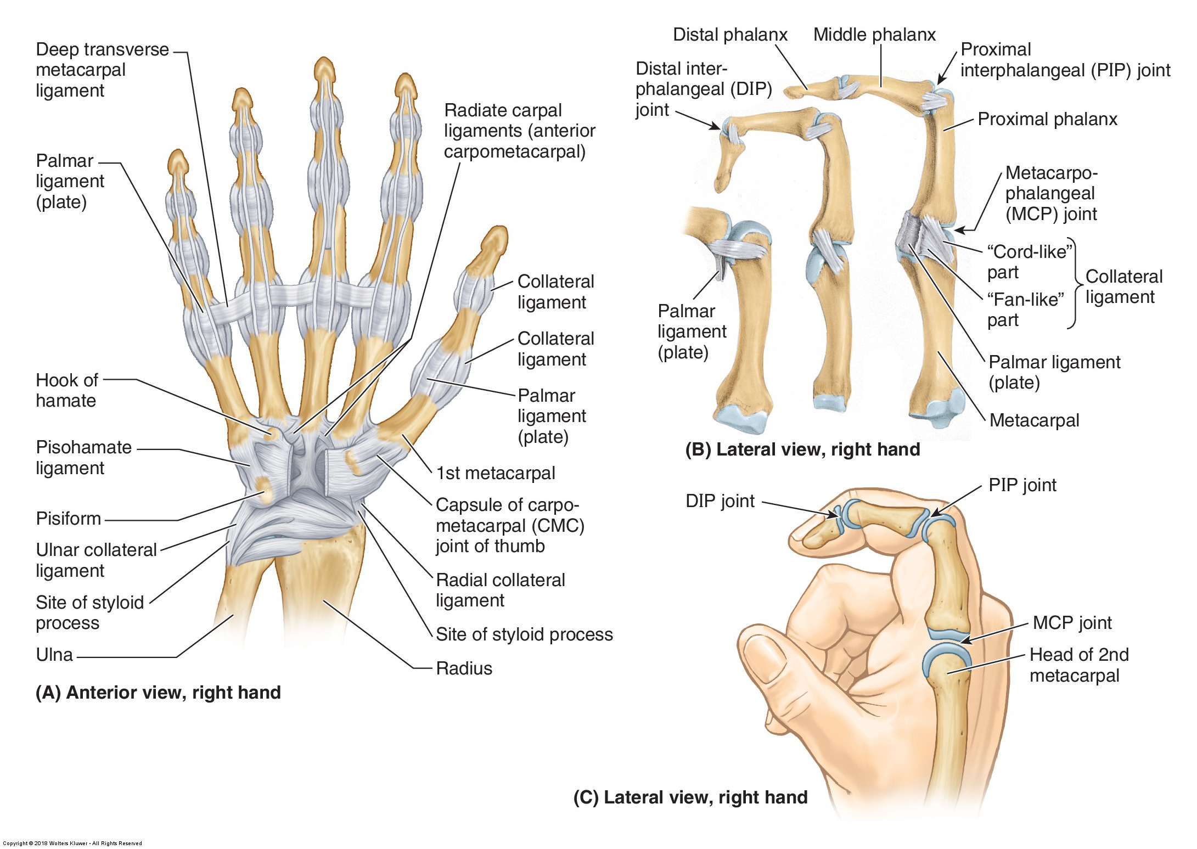
MCP, PIP, DIP joints
Metacarpophalangeal = MCP
Movements include flexion, extension, adduction, abduction and circumduction.
The 1st metacarpophalangeal joint movements are only flexion and extension.
Proximal Interphalangeal = PIP
Distal Interphalangeal = DIP
Movements are flexion and extension.

Slide 11
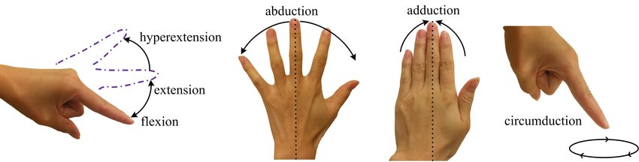
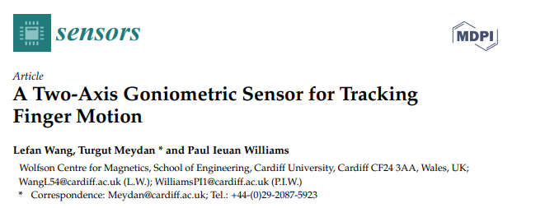
Digit Range of Motion
3rd digit!!!!

Slide 12
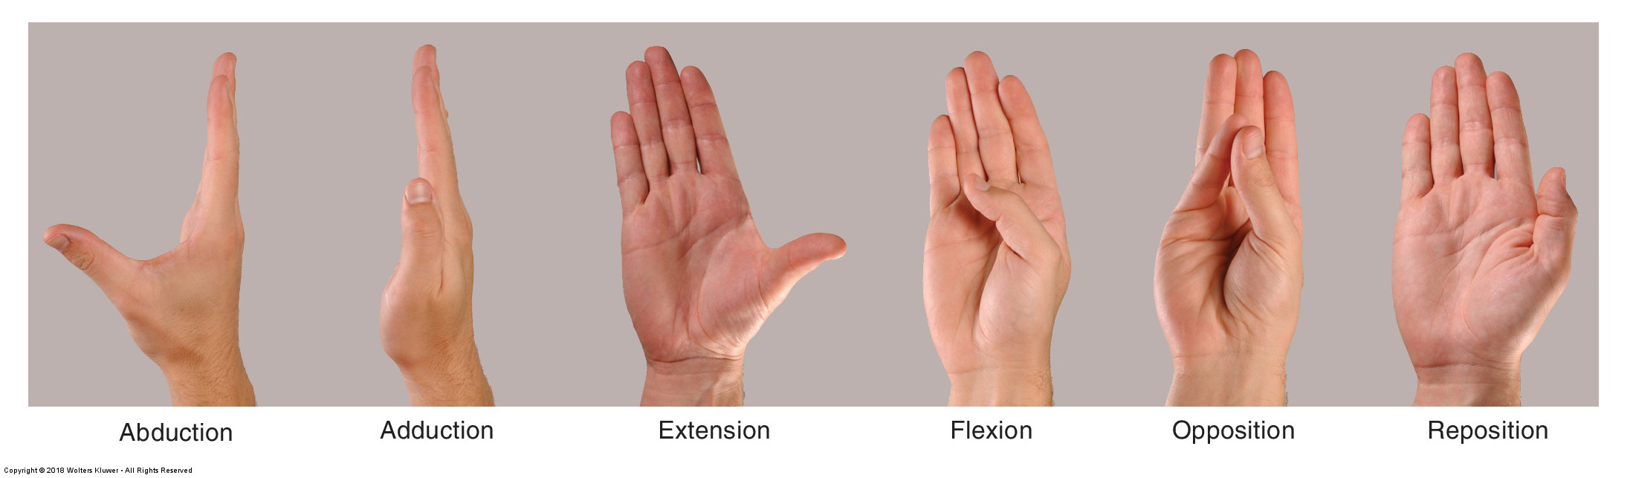
Movements of 1st digit

Slide 13
Palmar carpal ligament & Flexor Retinaculum
Copyright © 2019 by Saunders, an imprint of Elsevier Inc.

Slide 14
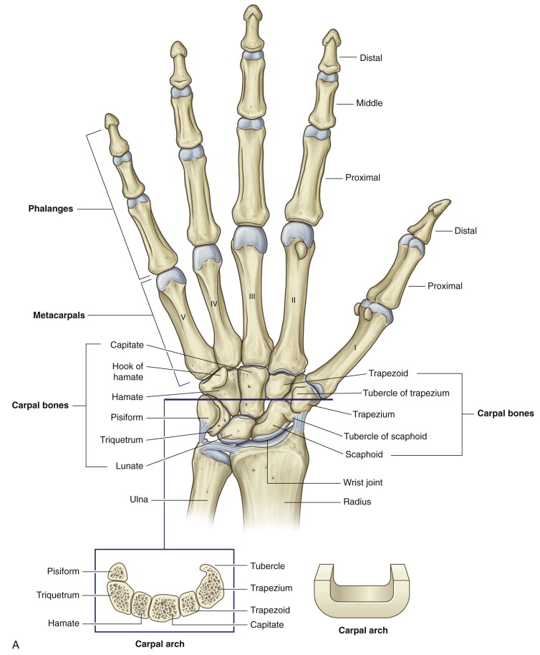
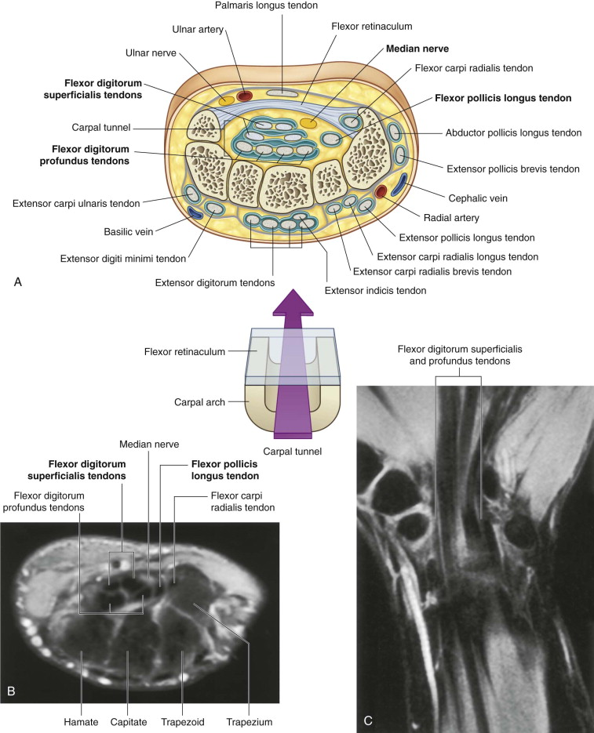
Carpal tunnel
Medial
Lateral
Copyright © 2020 Elsevier Inc.

Slide 15
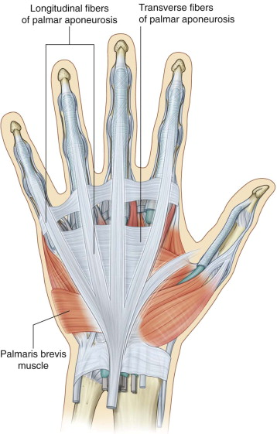
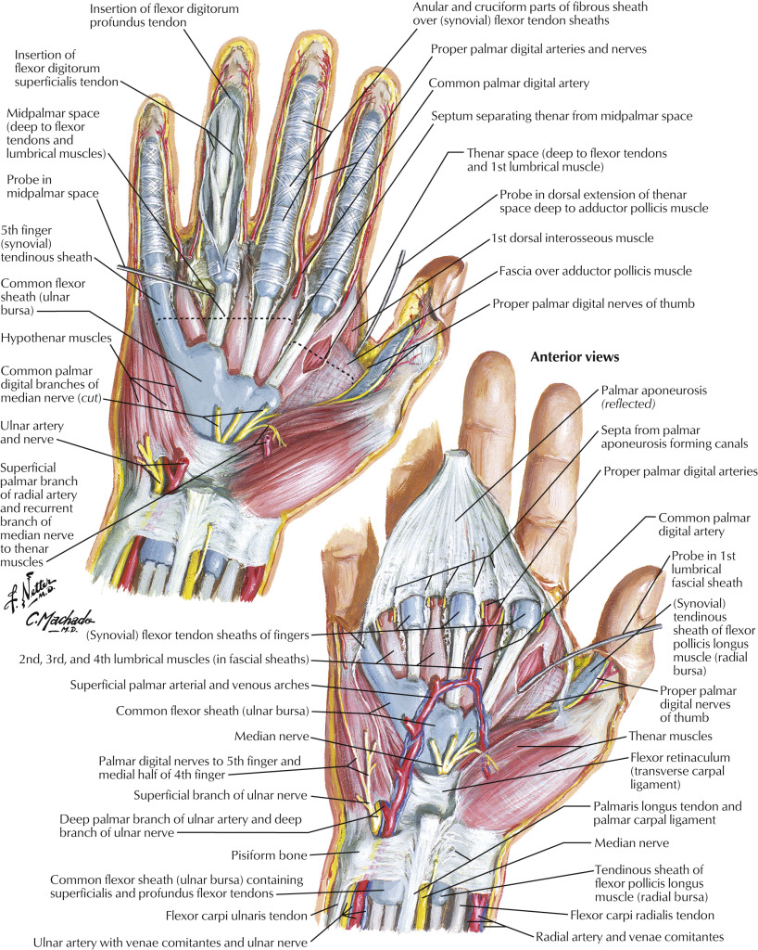
Palmar aponeurosis
Palmar aponeurosis
Palmar carpal ligament
Palmaris longus tendon
Copyright © 2019 by Saunders, an imprint of Elsevier Inc.
Copyright © 2020 Elsevier Inc.

Slide 16
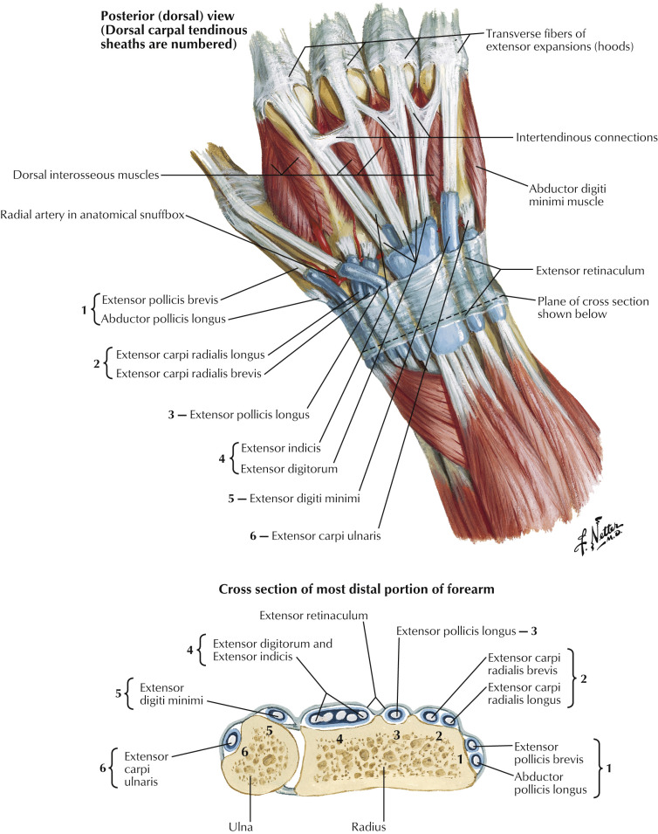
Synovial Sheaths
Extensors
Copyright © 2019 by Saunders, an imprint of Elsevier Inc.

Slide 17
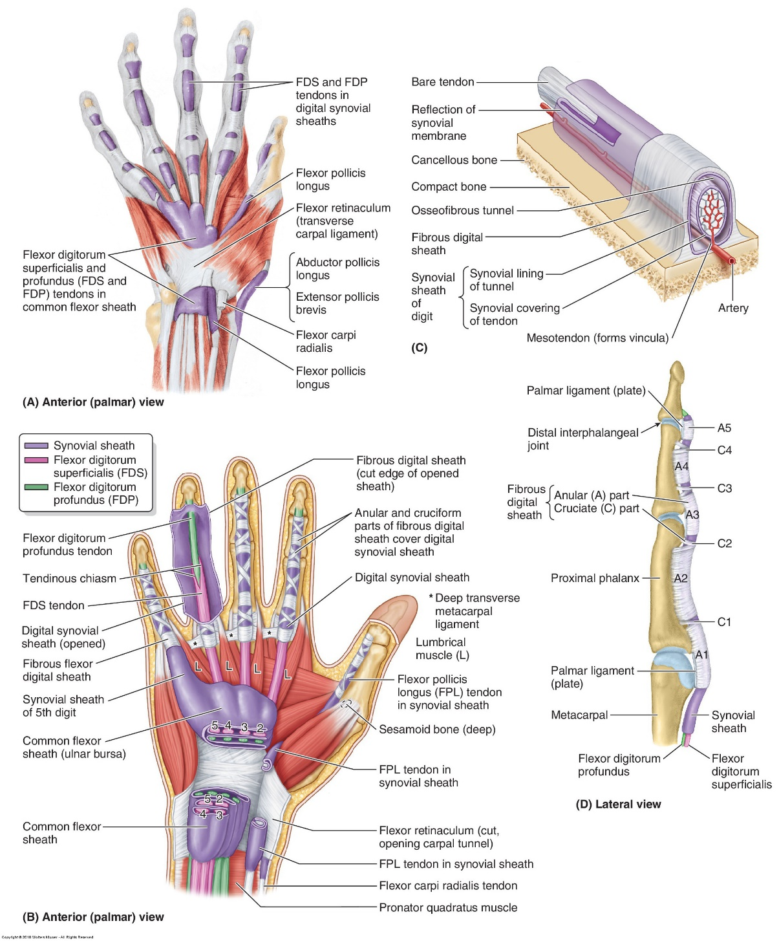

Synovial sheaths
Flexors
Radial bursa
Ulnar bursa

Slide 18
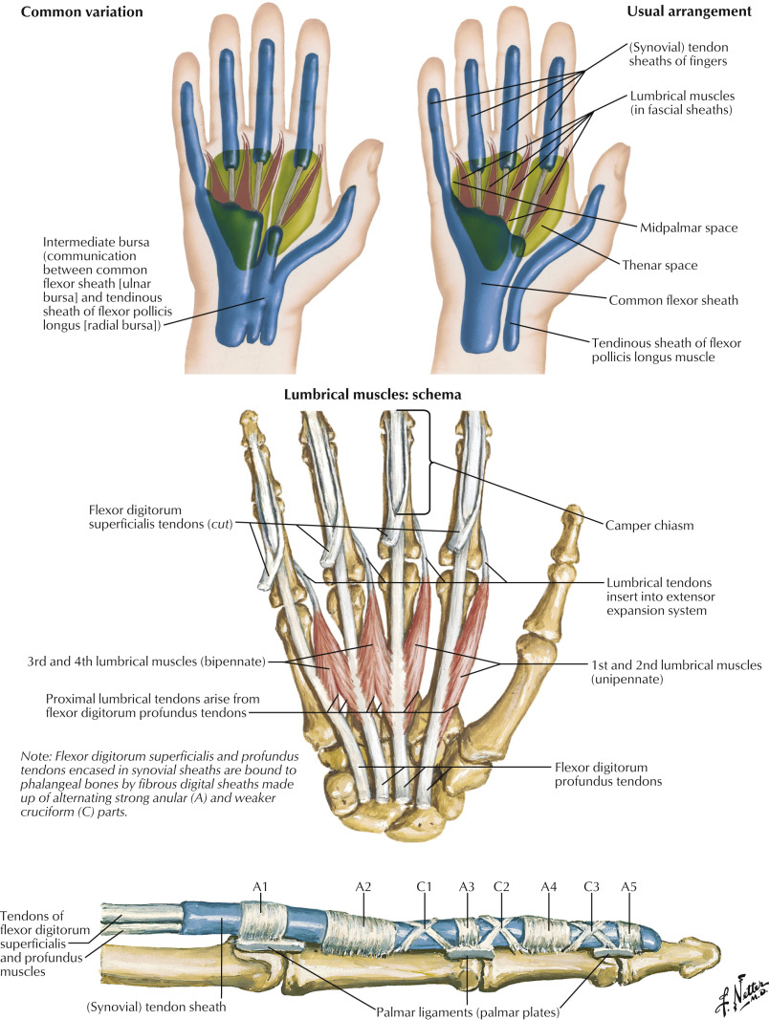
Fibrous digital sheaths
Copyright © 2019 by Saunders, an imprint of Elsevier Inc.

Slide 19
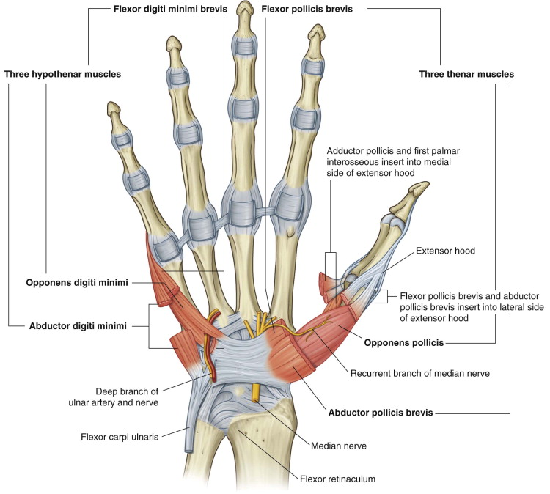
Thenar muscles
Abductor Pollicis Brevis
Attachments
Proximal - flexor retinaculum and tubercles of the scaphoid and trapezium
Distal - lateral side of the base of proximal phalanx
Function – Abduction
Innervation - recurrent branch of median nerve
Flexor Pollicis Brevis
Attachments
Proximal - flexor retinaculum and tubercles of the scaphoid and trapezium
Distal - base of proximal phalanx
Function - Flexion
Innervation – Superficial head is recurrent branch of median nerve. Deep head is deep branch of ulnar nerve.
Copyright © 2020 Elsevier Inc.

Slide 20
Thenar muscles
Opponens Pollicis
Attachments
Proximal - flexor retinaculum and tubercles of the scaphoid and trapezium
Distal - lateral side of 1st metacarpal
Function - Opposition
Innervation - Recurrent branch of median nerve
Copyright © 2020 Elsevier Inc.

Slide 21
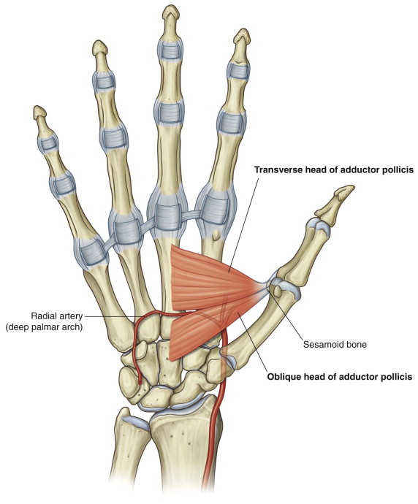
Thenar muscles
Adductor pollicis
Attachments
Proximal - 3rd metacarpal, capitate
Distal - base of proximal phalanx (medially)
Function - adduction
Innervation - deep branch of ulnar nerve
Copyright © 2020 Elsevier Inc.

Slide 22
Hypothenar muscles
Abductor Digiti Minimi
Attachments
Proximal - pisiform and flexor retinaculum
Distal - medial side of base of 5th proximal phalanx
Function – abduction
Innervation - deep branch of ulnar nerve
Flexor Digiti Minimi Brevis
Attachments
Proximal - hook of hamate and flexor retinaculum
Distal - base of 5th proximal phalanx
Function - flexion
Innervation - deep branch of ulnar nerve
Copyright © 2020 Elsevier Inc.

Slide 23
Hypothenar muscles
Opponens digiti minimi
Attachments
Proximal - hook of hamate and flexor retinaculum
Distal - medial side of 5th metacarpal
Function - flexion and lateral rotation of 5th metacarpal
Innervation - deep branch of ulnar nerve
Palmaris Brevis
Attachments
Proximal - medial border of the palmar aponeurosis
Distal - skin on medial border of the hand
Function - tightens the skin over the hypothenar eminence
Innervation - superficial branch of the ulnar nerve
Copyright © 2020 Elsevier Inc.

Slide 24
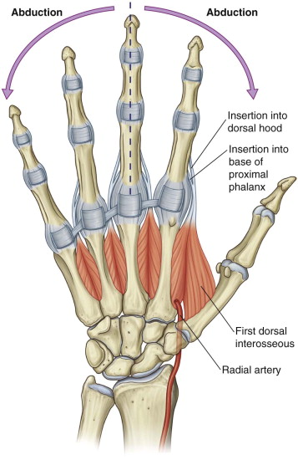
Dorsal Interossei
Dorsal interossei
Attachments
Proximal - metacarpal shafts
Distal - base of proximal phalanx of 2nd, 3rd, and 4th digits.
Function - abduct digits away from midline
DAB = Dorsal interossei ABduct)
Innervation - deep branch of ulnar nerve
DAB
Copyright © 2020 Elsevier Inc.

Slide 25
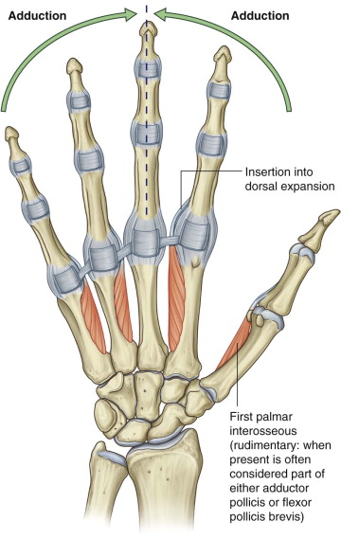
Palmar Interossei
Palmar interossei
Attachments
Proximal - metacarpal shafts
Distal - base of the proximal phalanx of same digit as its proximal attachment
Function - adduct 2nd, 4th, and 5th digits toward midline
PAD = Palmar interossei ADduct)
Innervation - deep branch of ulnar nerve
PAD
Copyright © 2020 Elsevier Inc.

Slide 26
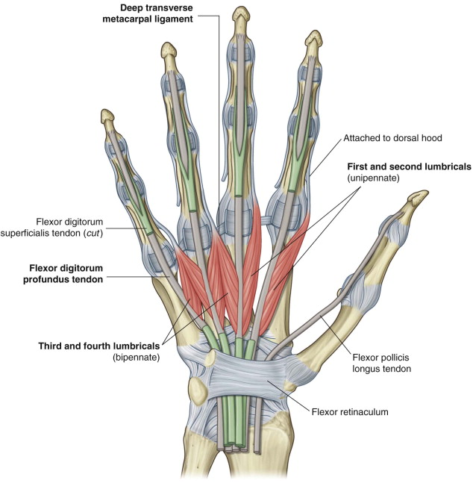
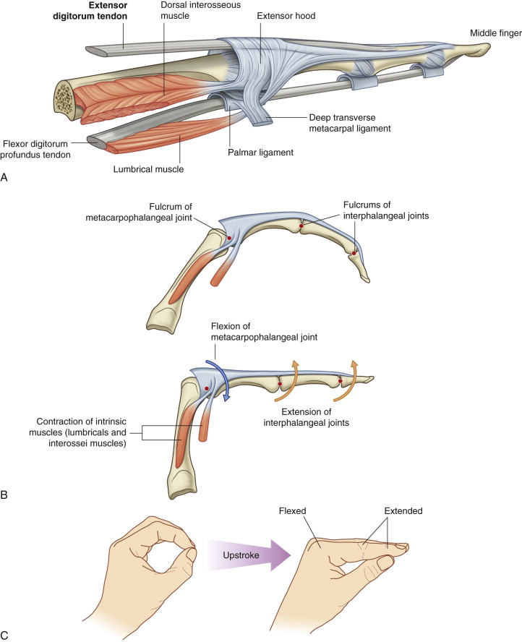
Lumbricals
Lumbrical muscles
Innervation –
first two (2nd and 3rd digits) from the median nerve,
last two (4th and 5th digits) from the deep branch of the ulnar nerve.
Copyright © 2020 Elsevier Inc.

Slide 27
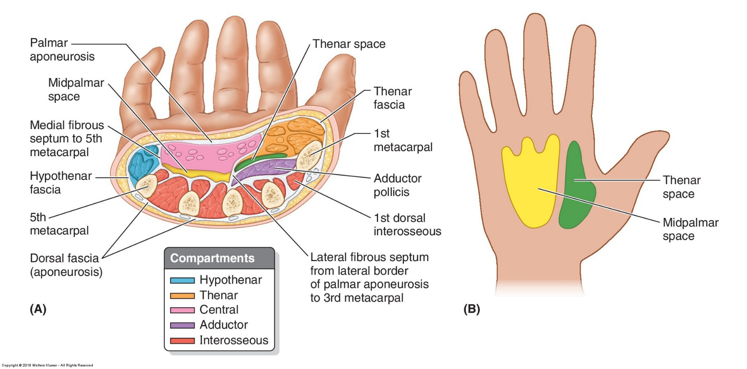
Spaces and compartments
Hypothenar compartment
Associated with the 5th digit.
Contains the hypothenar muscles.
Is isolated by a medial fibrous septum that extends from the medial edge of the palmar aponeurosis to the 5th metacarpal.
Thenar compartment
On the lateral side of the hand, associated primarily with the thumb.
Contains the thenar muscles.
Is separated from other compartments and spaces mainly by the lateral fibrous septum that extends from the lateral edge of the palmar aponeurosis to the 3rd metacarpal.
Midpalmar space
Deep to the flexor tendons.
This space extends through the carpal tunnel to the anterior compartment of the forearm.
Spread of infection can occur in this space from the forearm to the hand and vice versa.
Central compartment
Deep to the palmar aponeurosis, anterior to the midpalmar space, and between the lateral and medial fibrous septa.
Contents include:
Long digital flexor tendons, lumbrical muscles, superficial palmar arterial arch, digital vessels and nerves
Adductor compartment
Contains the adductor pollicis muscle.

Slide 28
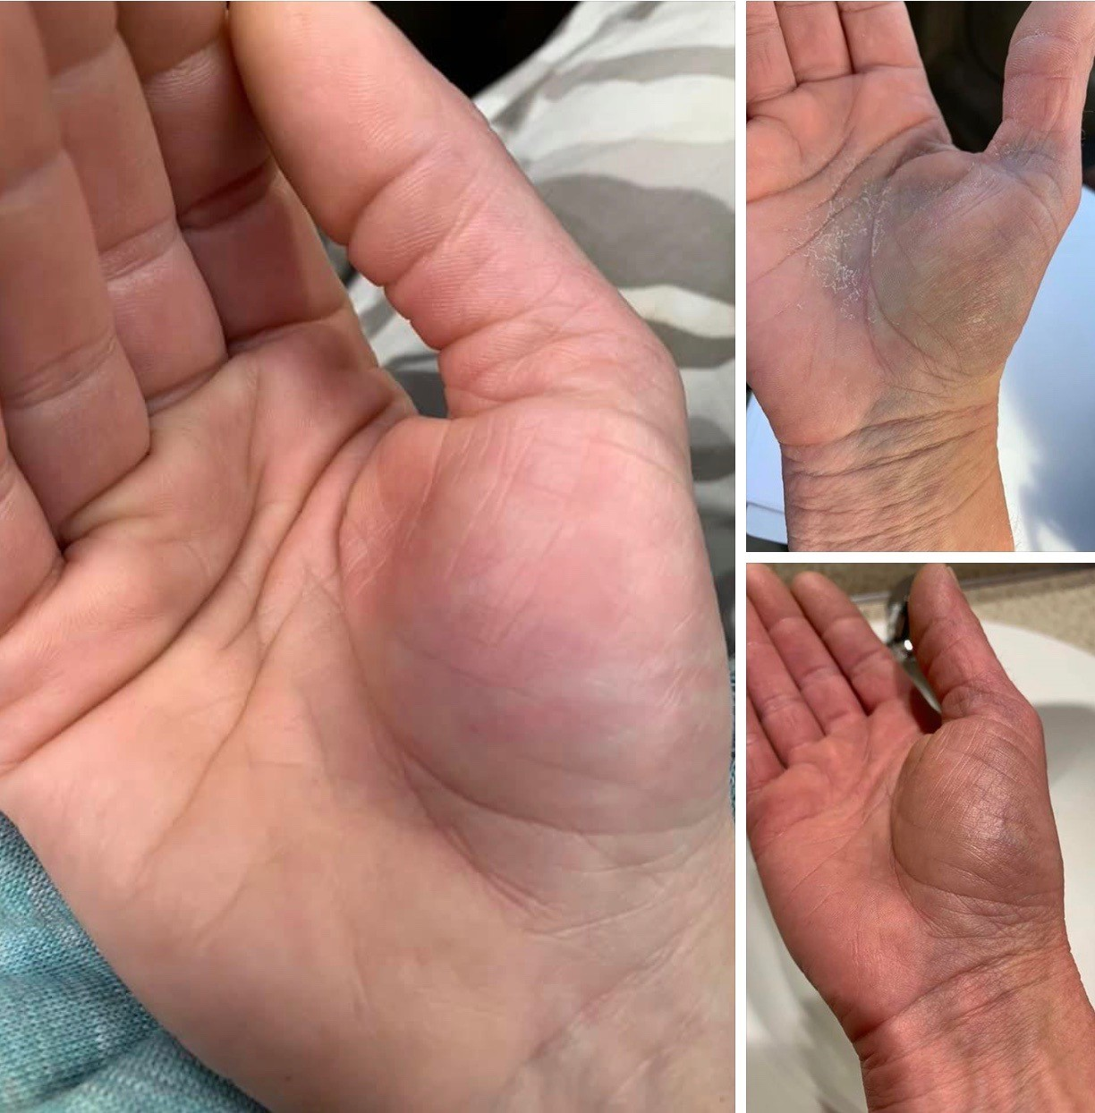
Images used with permission. Do not duplicate.

Slide 29
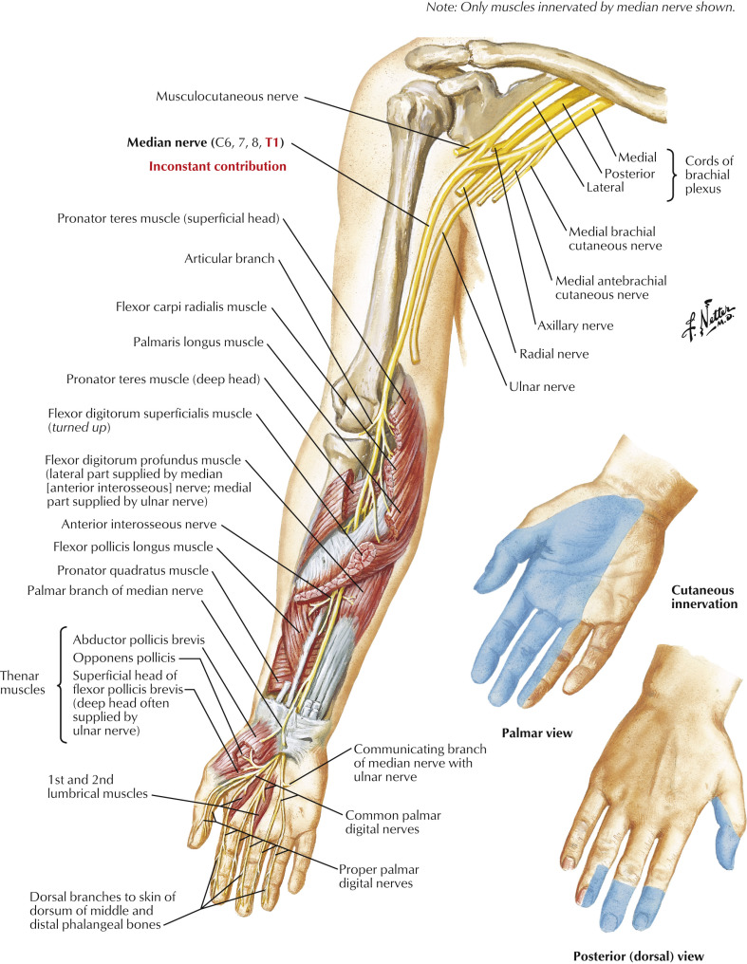
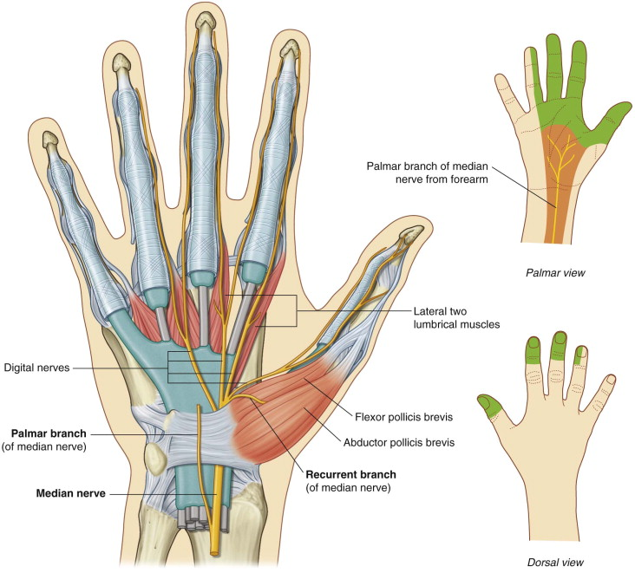
Median nerve
Copyright © 2020 Elsevier Inc.
Copyright © 2019 by Saunders, an imprint of Elsevier Inc.

Slide 30
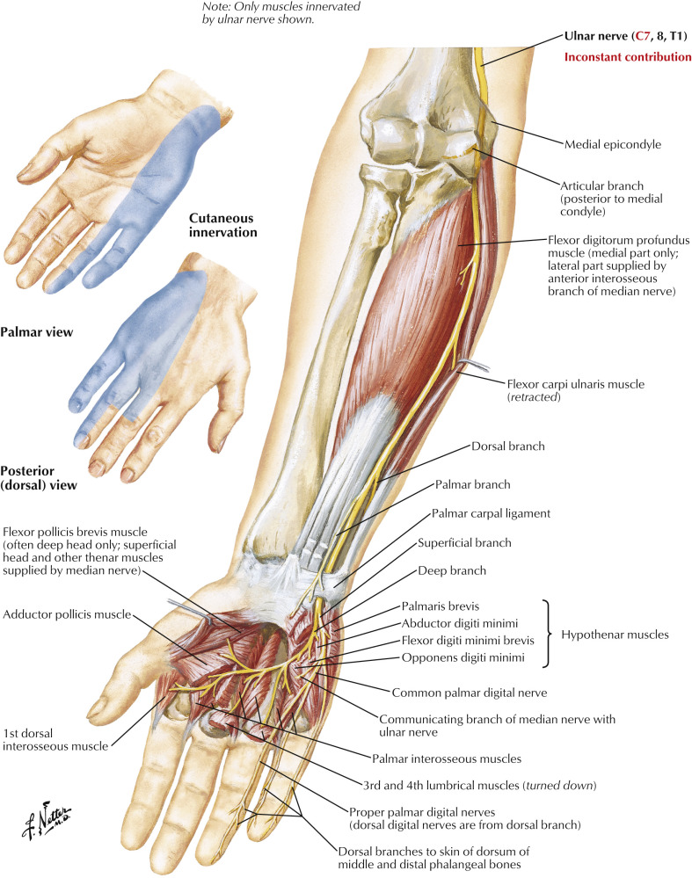
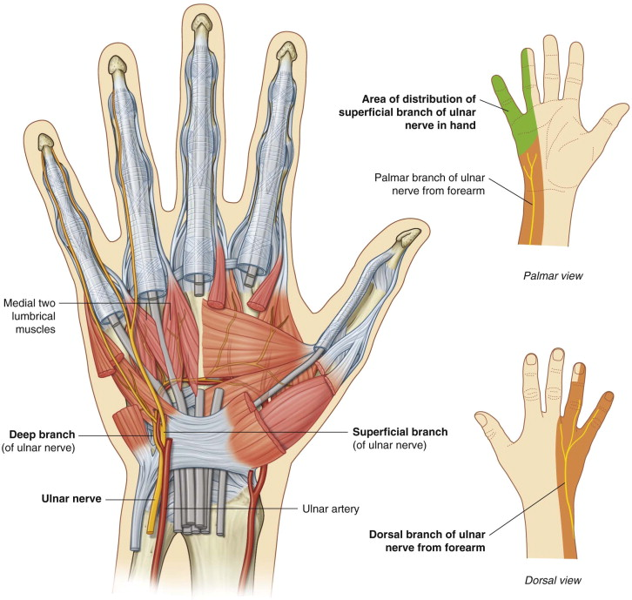
Ulnar nerve
Copyright © 2020 Elsevier Inc.
Copyright © 2019 by Saunders, an imprint of Elsevier Inc.

Slide 31
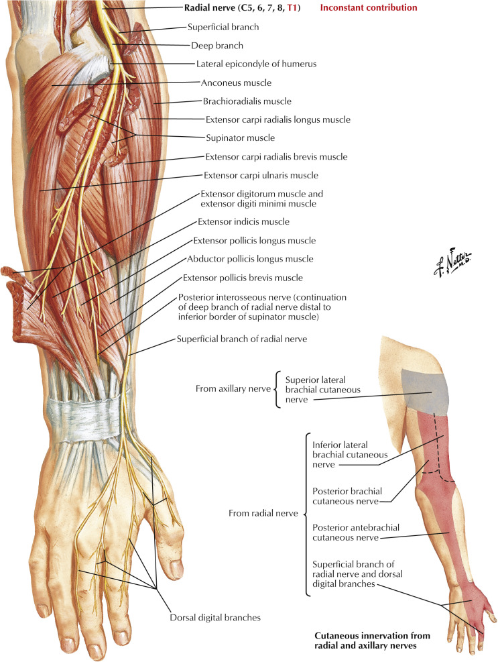
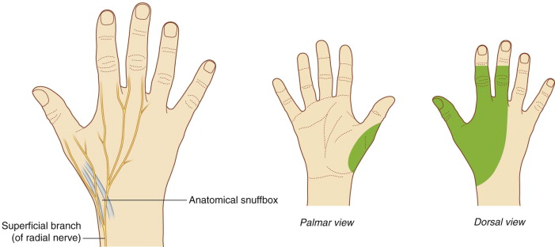
Radial nerve
Copyright © 2020 Elsevier Inc.
Copyright © 2019 by Saunders, an imprint of Elsevier Inc.

Slide 32
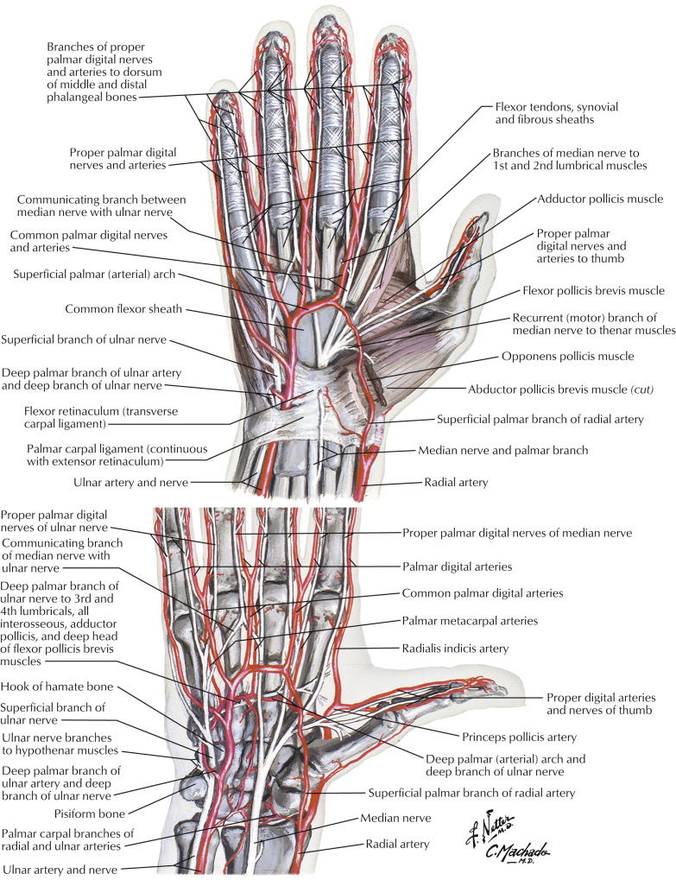
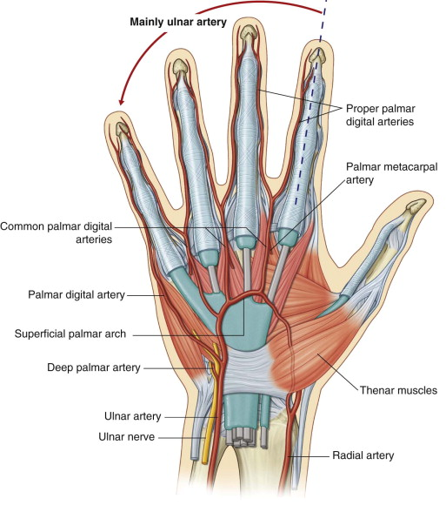
Ulnar artery
Copyright © 2020 Elsevier Inc.
Copyright © 2019 by Saunders, an imprint of Elsevier Inc.

Slide 33
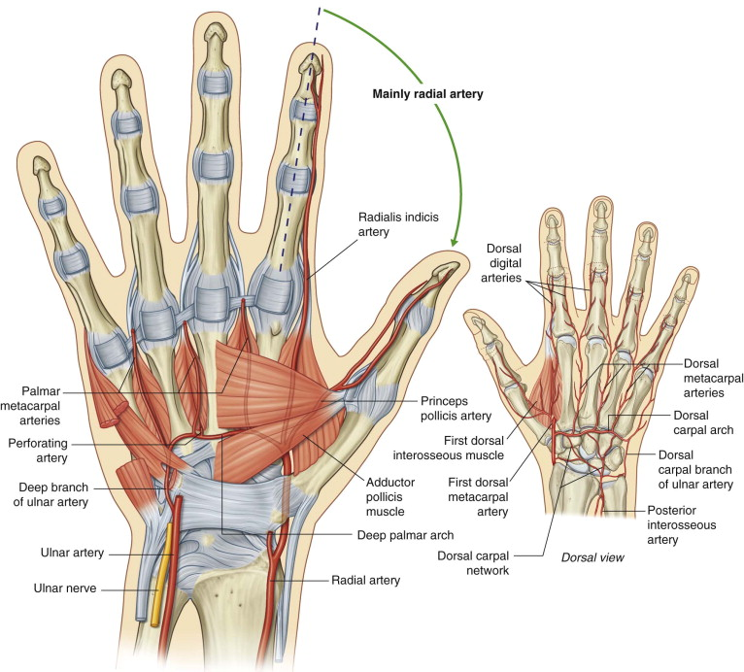
Radial Artery
Copyright © 2020 Elsevier Inc.
Copyright © 2019 by Saunders, an imprint of Elsevier Inc.

Slide 34
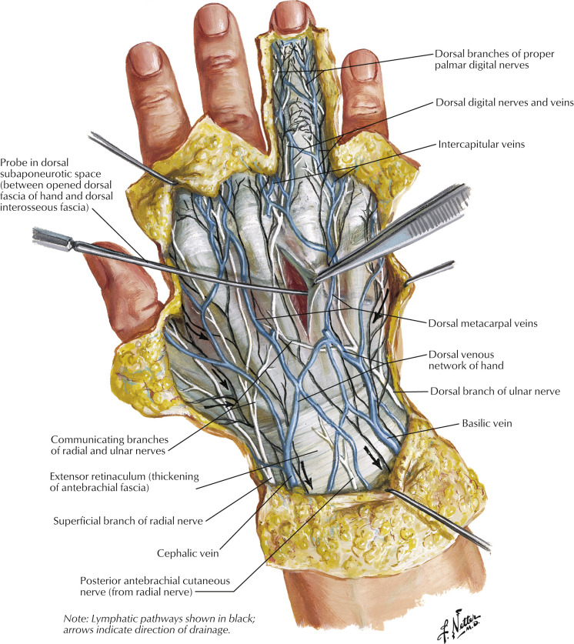
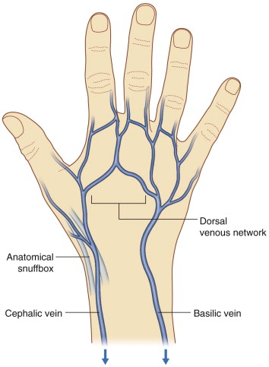
Veins & lymphatic vessels
Copyright © 2020 Elsevier Inc.
Copyright © 2019 by Saunders, an imprint of Elsevier Inc.

